Slide 1
AJ-MOFA technical report
Eng- Mohammad Sakka

Slide 2
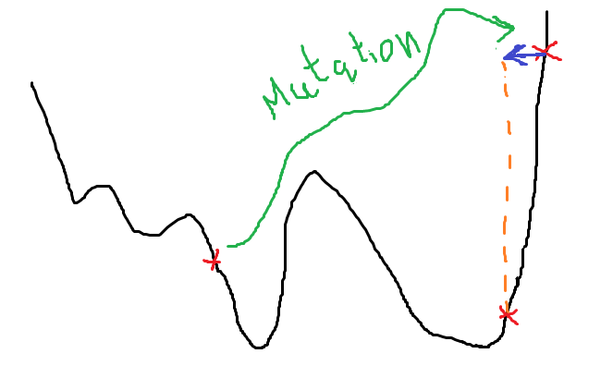
developements
doing the following modifications on firefly algorithm
1- exploration then exploitation factor:
modifiedMutation pseudocode:
if rand < exp(1-10*(iter/maxIter))
sol=unifrnd(sol)
If sol is not improved
sol=normrnd(sol,(ub-lb)*0.05)
end

Slide 3
developements
2- modifying Gstar determination method
pseudocode:
1- select random obj
2- create pdf based on selected obj
3- select Gstar using roulette wheel

Slide 4
developements
3- modifying (Leader and Gstar) equations use
// Moving not moved Solutions towords Gstar or Leader
New pseudocode:
if rand < exp(1-10*(iter/maxIter))
// for the earlier iterations, the chance of objectives decomposition is bigger
// but in the last iterations the chance of Leader effect is bigger, so it is adaptive jumping algorithm
Sol = Sol + jumbingCF * rand(size(Sol)) * (Gstar-Sol)
else
Sol = Sol + jumbingCF * rand(size(Sol)) * (Leader-Sol)
End
// we have used separate compensation factor for Leader and Gstar and name it “jumpingCF”
// “jumpingCF” can be similar to CF or different value
Old pseudocode:
Sol =rand * Gstar + rand * Leader + steps
// this formula is not logical since it make all not moved solutions at the current iteration are merge of the Gstar and Leader positions but not consider the previous solution position !!

Slide 5
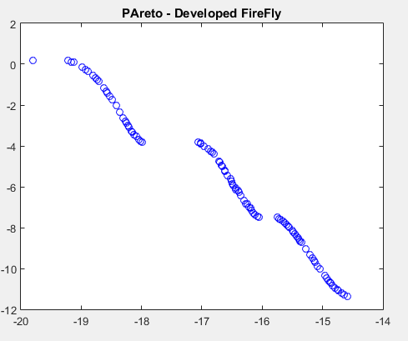
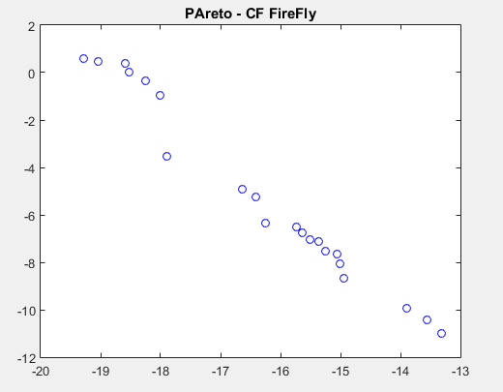
developements
4- adding Gaussian mutation
5- modifying the method of deletion from Ext Archive
Using roulette wheel
IdxsToRemove = rouletteWheel(1/crowdDist)

Slide 6
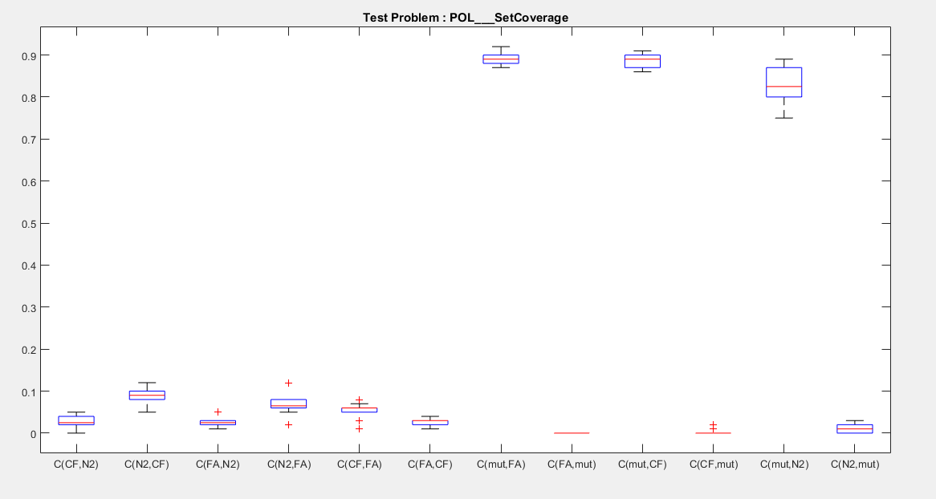
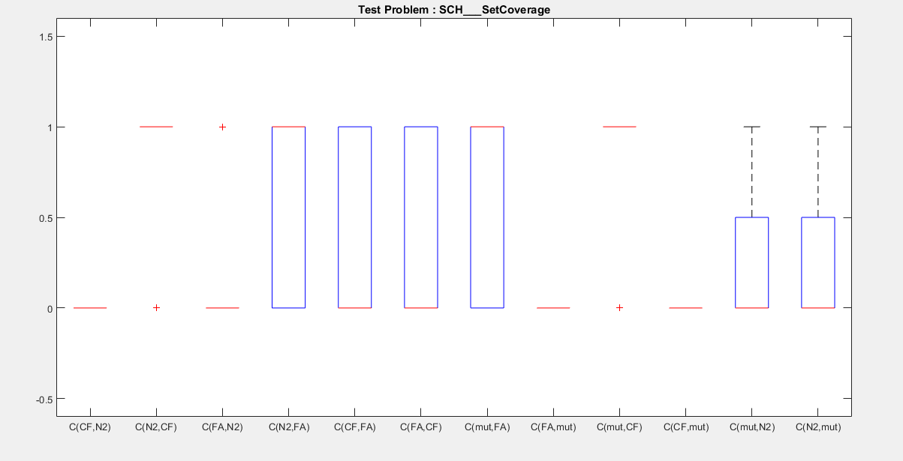
results

Slide 7
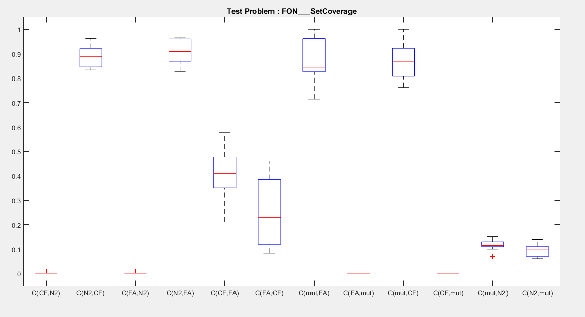
results

